Slide 1
Year 12 Information night 2024
Notes:
I’d like to welcome you all here tonight. This is our 4th webinar – so we are getting used to the concept
My name is Teresa Hanel and I am the Director of T&L and I also of Careers Counsellors as well at the Vet coordinator.

Slide 2
Question and Answers
Please use the Q and A at the bottom of the screen or we are more than happy to respond to your questions as we go.
Teresa Hanel thanel@scotch.sa.edu.au
Belinda Sorensen bsorensen@scotch.sa.edu.au
Sam Smith ssmith@scotch.sa.edu.au
Janet Rainey jrainey@scotch.sa.edu.au
Notes:
You will notice on your screen either at the top or bottom there is a Q&A button. We are happy to take questions in here and answer as we go through the presentation.
This presentation is being recorded tonight and will be available on the website tomorrow in the Teaching and Learning section along with a copy of this powerpoint.

Slide 3
SACE Requirements
Notes:
I just wanted to remind you of the SACE requirements – 200 credits in total.
Compulsory – English, Maths and RP all completed this year.
The majority of our students will have 150 credits or more by the end of the year, so would have 230 credits when they finish
For 2023 I would expect the majority of our students to study 4 subjects..

Slide 4
2024 Subjects for Year 12
Research Project - compulsory
Can choose 3, 4 or 5 subjects
3 subjects – SACE completion
Recommend 4 for ATAR
Notes:
3 subject s only – students looking for SACE completion only
Majority will do 4 subjects. – this is what I would recommend
There is an opportunity to study 5 if a student wanted to – might be they are considering going to an interstate Uni and need English in the mix.
The Research Project is compulsory and half of the cohort have finished already – just waiting for the next group to finish by the end of this term

Slide 5
Subjects Year 12
Preferences will be due Thursday August 17
Agriculture | Design & Technology - Materials | Essential English | Media Studies | Music – many types
Biology | Design & Technology - Textiles | Essential Maths | General Maths | Nutrition
Business Innovation | Drama | EAL | Health & Wellbeing | Philosophy
Creative Arts – Film Creative Arts - Photography | English | Food and Hospitality | Maths Methods | Psychology
Dance | English Literary Studies | French and Chinese | Modern History | Outdoor Education
Physics Digital Tech | Physical Education Media Studies | Specialist Maths Music | Visual Art – Art Visual Art - Design | University Headstart Extension Studies VET options
Notes:
34 options that students can study at Year 12.
I will talk about the subject areas shortly, including the university options.
Mark Kelly will talk about the VET options as well

Slide 6
English
Stage 2 subject choices 2024:​
English​ Literary Studies
English
Essential English
English as an Additional Language ​
Head of Faculty – Michael Rodenburg mrodenburg@scotch.sa.edu.au
Notes:
Starting with the different areas – English has four streams at Year 12.
English Literary Studies has an exam component worth 15% and goes for 90 minutes- and it will be done online. The subject has a focus on skills and strategies to interpret text.
English – no exam- they will explore the purpose of text
Essential English – no exam – here the students will respond to text.
EAL – has an exam 2 and half hours – this is for students where English is not their first language
Current Teachers can help students to decide which is the best pathway for term.
That is in all the subject areas - the teachers currently at Year 11 can provide the best advice for the which subject they are suited.
I have included the Head of Faculty in each of the areas as well with their contact details – so in this case it is Michael Rodenburg

Slide 7
Sciences
Notes:
In the Sciences – we have Chemistry, Physics and Biology and Psychology
Students need to ensure that they are familiar with the SATAC guide – making sure that they are choosing correctly for University courses.
Pre-requisites and assumed knowledge are important here.
An example – Flinders Uni Chemistry is a pre-requisite for Forensic and Analytical Science
Or Veterinary Bioscience at Adelaide uni has a pre- req of one of Biology, Chemistry or Maths Methods and assumed knowledge of Physics
Pre-requisite means a student MUST have studied the subject. Assumed knowledge means that students should expect that particular subject content but don’t have to demonstrate a background in it.
Year 12 Biology and Psychology can be studied at year 12 level without having previously studied in year 11.

Slide 8
Sciences
Sciences
Head of Science – Michelle McGrath mmcgrath@scotch.sa.edu.au
Notes:
And this is the same for Agriculture, Nutrition or Sport Science.
So if you didn’t study this in Year 11 and you had a definite interest then it’s possible to do this.
Ag, Sport Science have no exam
But Chem, Physic, Biology, Psych, Nutrition all have exams and are two hours
Biol, Psych and Nutrition are all online examinations
Nutrition looks at food production and the role of nutrients in the body, as well as social and environmental issues.
The Head of Faculty is Michelle McGrath and I have included her details on this slide.

Slide 9
Mathematics
Head of Mathematics Olga Kumar okumar@scotch.sa.edu.au
Notes:
Maths like English has four streams as well. All of the subjects have exams and they are all now two hours.
Essential Maths – has an emphasis on practical skills in the workplace
General Maths – prepares students for tertiary courses that have a non- specialized background in Maths like Early Childhood Teaching, Primary Teaching and some commerce areas
Maths Methods – prepares students for further study in Maths, Economics, Computer Science and the Sciences
Specialist Maths – is studied with Maths Methods – this is for students who want to study mathematical science, engineering, space science and computer science.
Olga Kumar can help you with subject choices here, as well as the current subject teachers

Slide 10
Languages
Year 12
French Stage 2 (Continuers)
Chinese Stage 2 (Background Speakers)
External Languages
Head of Languages – Nhu Trinh
ntrinh@scotch.sa.edu.au
Notes:
Generally students who have studied a language will continue through to Year 12. The exams for students re now two hours.
There is an opportunity for students who are studying Korean, German or Japanese to continue their language study at the school of languages or Open Access
Nhu Trinh is currently in charge of Languages while Jess Powell is on maternity leave.

Slide 11
Health and PE
Year 12
Health & Wellbeing
Physical Education
Outdoor Education
Head of Health and PE – Mark Goreham mgoreham@scotch.sa.edu.au
Notes:
The subject health and Wellbeing covers the health and wellbeing of individuals, communities and global societies.
Physical Education looks at the movement, social psychology and physical performance
Outdoor Ed – three main areas – sustainability, human connections with nature and personal growth.
There are no exams for any of these subjects and it’s possible for a student to study in these subject areas with having studied in year 11
Mark Goreham can give you more information around these subject areas.

Slide 12
Technologies
Subject | Stage 1 Subjects (1 Semester & 10 credits) | Stage 2 Subjects (20 credits)
Design, Technology & Engineering – Material Solutions ( Wood or Metal) | Stage 1 – 10 credits | Stage 2 - 20 credits
Food & Hospitality | Stage 1 – 10 credits | Stage 2 – 20 credits
Art Photography Design (Stage 2 only with approval from Head of Faculty) | Stage 1 – 10 credits Stage 1 – 10 credits Stage 1 – 10 credits | Visual Art – Art 20 credits or Visual Art – Design 20 credits Creative Arts – Photography 20 credits (students CANNOT study both Art and Design)
Design, Technology & Engineering – Textiles Digital Technology | Stage 1 – 10 credits Stage 1 – 10 or 20 credits | Stage 2 – 20 credits Stage 2 – 20 credits
Film Making | Stage 1- 10 credits | Stage 2 – 20 credits
Head of Technologies – Amanda Johnson ajohnson@scotch.sa.edu.au
Notes:
Technologies – Material Solutions many of you would have already studied this this year. I have already had a request to study the wood component as the student has worked with metal this year – this can’t happen as it’s exactly the same subject but just working in a different medium. So students will be able to do Wood or Metal but not both.
Textiles – this is our Fashion stream
Film Making – again most students would do this subject in year 11, however a student could pick this up in year 12 if they were passionate about the area.
Food & Hospitality – looks at the impact of the industry on Australian society
Art, Design – a student can only do on of these subject sat this level.
There are no exams for any of these subjects – it’s about the Design, proto- types and practicals that are important
Amanda Johnson can help you out here

Slide 13
Performing Arts
Year 12
Music –Exploration, Performance Ensemble, Performance Solo, Music Studies
Drama
Dance
Coordinator of Music Briony Nickels bnickels@scotch.sa.edu.au
Coordinator of Drama Nicola Triglau ntriglau@scotch.sa.edu.au
Coordinator of Dance Allison Patterson apatterson@scotch.sa.edu.au
Notes:
Music has two 10 credit subjects – Performance Ensemble and Solo Performance, these are usually done as part of the Band or Orchestra.
Solo Performance – this is done around the students instrument of choice – which includes Voice
Music Studies and Music Exploration are both 20 credits. Music Studies has a final examination.
Drama – students are part of. Group production as well as a creative presentation or performance
Dance – the majority of our students would have completed this in Year 11

Slide 14
Humanities
Media Studies
Business Innovation
Philosophy
Modern History
Economics
Geography
Head of Humanities – David Albano
dalbano@scotch.sa.edu.au
Notes:
Media Studies looks at World events and information and how the Media has influences. Deep Fake Technology has been studied
Business Innovation - looks at Customer needs, project management and decision making around business models
Philosophy – students study ethics, epistemology, and metaphysics
There are no exams for these subjects and each of them could be studied at Stage 2 level without Stage 1
Modern History – has a 2 hr exam; The two topics that are looked at are
Struggle for peace in the Middle East
Soviet Union and Russia
Economics – has a 2 hr exam the topics The four main areas are : economic inquiry skills, data analysis, micro and macro economics. This subject is new for 2023.
Both History and Economics could be picked up at Stage 2 level without year 11 , but I would suggest that English is also a favourite subject.
David Albano is happy to assist here

Slide 15
Vocation Education Training - VET
VET courses are designed to cater for specific interests or work ready qualifications
VET courses attract SACE credits (either Stage 1 or Stage 2)
RTOs (Training Providers) are located across Adelaide. The location of the course remains a key issue in selection
Can be used as a pathway towards further study, trade or apprenticeship
Some courses have placement requirements from 30 to 120 hours on top of the coursework requirement
Some students participate in courses run on full days during the year (ie Thursday). Others participate online or after school hours. Still others have online course work and 1 to 3-day workshops
For further general information go to Scotch Life – Future Careers and Pathways – VET@Scotch
Contact
Belinda Sorensen – Cameron & Douglas
Sam Smith – Gordon & Campbell
Janet Rainey – McGregor & Stewart
Notes:
Essentially VET allows for specific skills based training while at school. For example, skills in the fields of Plumbing, Carpentry, Metal Fabrication, Health and Beauty, Early Childhood Care & Support, Automotive, Rural Operations, etc.
The location of VET courses can vary from Regency Park, Tonsley, Noarlunga and Mt Barker to the city. VET courses usually last between 12 months and 18 months , and normally completion of a Certificate 2 level course is awarded Stage 1 SACE credits while completion of a Certificate 3 level course is awarded Stage 2 SACE credits.
VET courses are really designed for students who want to develop practical skills in a specific area of interest, possibly with a view to commencing an apprenticeship or traineeship after completing their SACE.
VET courses do present some challenges as they mostly require students to miss school each week, and Cocurricular commitments (such as Sport) may be impacted by the VET course. The location of courses can cause transport and logistical difficulties, and some VET courses require the completion of compulsory work experience placements during the course (30 – 120 hours, depending on the course). As you can see, students need to be highly organised and self-motivated to succeed in a VET course while completing their SACE.
If you think studying a VET course in 2024 aligns with your career aspirations please check out the information in Scotch Life and also speak with the Careers Counsellor and VET Coordinator for your House as soon as possible. There is a lengthy application process that involves the completion and documentation of at least 2 days of work experience before we can start lodging an application in Week 7 of this term.

Slide 16
Extension Studies – Flinders University
The Extension Studies Program offers high-achieving senior secondary students an opportunity to study subjects
Semester subjects
Ageing Studies, Archaeology, Biology, Business, Chemistry, Computer Science, Criminal Justice, Drama, Design, Disability, Earth Science, English, Engineering, Languages, Geography, History, Health & PE, Health Sciences, Innovation, Law, Medicine, Nutrition, Physics, Politics, Psychology, Screen & Media, Sociology, Statistics, Visual Arts, Women’s Studies
Notes:
Students can also study at University – Extension Studies through Flinders University
They offer semester courses and you can see the wide range of subjects on offer. Flinders are very flexible, and I had a student this year who wanted to study Indigenous Studies – they allowed this to happen. I also have students studying Computer Science and Law.

Slide 17
Headstart – Adelaide University
Support of parents or guardians
Recommendation from the school and nomination of a School Mentor
Personal statement (max 250 words): This should include why the student is wanting to pursue the Headstart program, what are the motivating factors, how they found out about the Headstart program, plans for 2024 beyond, etc.
Courses in the Arts, Commerce, Computer Science, Heath Science, Mathematics, Sciences
Notes:
Similarly Headstart at Adelaide University. It is more competitive and students would need to have all A grades in Year 11 to be considered. Plus a recommendation from the school and. A personal statement. They offer courses in 7 areas.
I have students studying in the Arts – Law and Criminology

Slide 18
UniSA ACCELERATE
Study 100% online
Pathway to UniSA Business
Subjects you can study – Accounting for Business, Business Law, Communication and Media, Consumer Behaviour, Contemporary Aboriginal Issues, Intercultural Communication, Macroeconomics, Management, Marketing Principles, Personal Finance, Principles of Economics, Problem Solving and Programming, Data Analytics, Psychology and Retailing
Applications due in early January
Notes:
UniSA have a Business pathway for students. You can study up to two subjects and they can be done online. This pathway has only happened last year – we have one student who is currently in this program.

Slide 19
CQU – Start Uni Now (SUN) Program
Central Queensland University (online)
Semester subjects
Biology, Computing, Community, Criminology, Web Design, Education, Engineering, Journalism, Law, Marketing, Nursing, Psychology and Theatre

Slide 20
University conversion
High Distinction = 10
Distinction = 9.9
Credit = 9
Pass = 7.9
These are all 10 credit subjects and you can only count two towards your ATAR
Notes:
The conversion rates are very good for students. A high Distinction is worth 10 credits (and a merit) and counts towards the students ATAR.
If interested in exploring any of these opportunities further then a student just needs to register interest on the subject choice form, and I will get in contact with them later

Slide 21
Australian Tertiary Admission Rank (ATAR)
Measures a student’s overall achievement compared with other students
Used by universities to select students for university courses
Ranges from 0 to 99.95
Calculated from university aggregate – based on 90 credits of SACE Stage 2 for entry in 2024.
The best four and half subjects are used
Notes:
The ATAR is used for entrance into University. It’s. a ranking and is based on the students overall achievement compared to others in the cohort.
The ATAR is used in all states in Australia for Uni entry
Ranges from 0 – 99.95. Can’t get 100 as it’s a ranking and when we say 99.95 it means that the student is in the top 5% of the cohort
Uni Aggregate is based on the best 4 and half subjects. The ATAR forms part of SACE completion.

Slide 22
Calculating an ATAR
EXAMPLE: Student A receives the following scaled scores.
Stage 2 Subjects | English | Maths Methods | Physics | Specialist Maths | Research Project
SACE credits | 20 | 20 | 20 | 20 | 10
Grade | A | A+ | A+ | A+ | A+
Scaled Score | 17.3 | 19.5 | 19.6 | 19.6 | 9.5
University Aggregate (out of 90) = 85.5
ATAR (based on 2022) ≈ 98.45
University Aggregate (with bonus) = 89.5
Selection Rank ≈ 99.95
Notes:
Student A has studied 4 and half subjects and has excellent grades based on the 2022 cohort will receive a 98.45
The scaled scores (I will talk about this later) are what is used to calculate the aggregate and I have not used any bonus points here (or adjustment factors) English and Maths Methods would mean the student gets 4 bonus points and this is added to the aggregate
At the beginning of next year I will start to give the students predicted ATAR’s based on their Year 11 results

Slide 23
Calculating an ATAR
EXAMPLE: Student B receives the following scaled scores.
University Aggregate (out of 90) = 77.05
ATAR (based on 2022) ≈ 90.5
University Aggregate (with bonus) = 79.05
Selection Rank ≈ 92.95
Notes:
This student studied Nutrition and the RP in Year 11. And their ATAR is 90.5
The Uni Aggregate comes from Nutrition, Chemistry, General Maths, History and half of the English score – as this is better that the RP
Bonus points will be for English only
SATAC is the organization that works out all of the ATARs - so they will calculate the best possible results for the students.

Slide 24
Scaling
Compares student performance in combinations of subjects
Fairness across the subject areas
Mathematical process called the SA Logistical Scaling procedure.
Exam based subjects
Why? For tertiary entry, defining academic merit
Choosing subjects – interests and abilities
Scaling video: see SATAC site https://www.satac.edu.au/pages/scaling
Notes:
What is scaling?
Scaling is a mathematical process that allows SATAC to compare overall performance of students in every possible combination of SACE subjects.
Why is it used?
Basically as some courses are competitive and the universities use this system to compare the overall performance of applicants. Scaling is used to make fair comparisons between different subjects.
Usually these subjects with an exam component hold their scaled scores better.
But choosing subjects based on scaling will likely not improve your ATAR. Subjects should be chosen on interests, and where a student will do their best.
I have included a video link on the SATAC site – for those who are interested in knowing more. It’s 12 minutes

Slide 25
Tertiary Pathways
Careers Counsellors
Belinda Sorensen – Cameron & Douglas
Sam Smith – Gordon & Campbell
Janet Rainey – McGregor & Stewart
Notes:
Careers exploration at Scotch begins in Year 10 when students complete the Morrisby testing. This helps start the process of identifying interests, aptitudes and potential career pathways that then influence subject choices going into Year 11.
Throughout Year 11 students have been able to experience more specialized content in their subject choices and pursue subjects more closely aligned with their interests. Their experiences with these subjects then helps to refine career ideas moving through to the start of Year 12.
Scotch students are supported throughout this process by one of our 3 Careers Counsellors and VET Coordinators. As you can see, students are allocated a Careers Counsellor based on their House.

Slide 26
Careers support in Year 12
Help clarify career directions
Help students plan (and have contingency plans) for their nominated career pathways
Provide predicted ATARs
Provide information and support with university applications
Support scholarship applications
Assist with university accommodation options and applications
Notes:
While Year 12 has a big focus on achieving strong academic results, it is also a time when students are making decisions about their future careers. It is very common for students to still be considering a range of career options at this age, and often talking with one of the Careers Counsellors can help them refine their plans and frame the key elements they need to consider to make these decisions.
We also help with providing information about the timelines and processes to research and apply for university courses and provide predicted ATARs throughout the year to help students know how they are tracking.
There are a range of university scholarships that students can apply for and we assist students in preparing these applications.
Another popular service we provide is to help students with university accommodation questions and applications.

Slide 27
Pathways after school
Higher Education Sector
University Courses
Requires completion of Year 12 & required ATAR
May have additional entrance requirements (UCAT, portfolio of work, audition, interview, prerequisites, etc)
Vocational Skills and TAFE courses (Cert II, Cert III,
Cert IV, Diploma, Advanced Diploma)
Can lead into uni courses (eg Bachelor degree)
Range of entrance requirements
VET/TAFE Sector
Requires getting a job (application, interview, etc)
Straight into earning money
May require on the job training
The Workforce
Notes:
There are essentially 3 longer term options for students when they finish Year 12. There is always an opportunity to move between these options as well. Entering the workforce immediately after SACE completion requires a different preparation for studying at TAFE or in the Vocational sector, and then again there are more complicated processes and requirements for students who wish to pursue university study. We offer practical support for all of the pathway options on this slide. But tonight I want to focus more on the requirements for entry to university as they are more involved and require significant research over the next few years to find the right match for each student.

Slide 28
Tertiary Destinations for 2022 Cohort
Notes:
To add some context to the support services that we provide students, here is a quick summary of the post school destinations for the 2022 cohort. This was again quite similar to previous Year 12 cohorts.
The majority of our students do attend university and most go to Adelaide University – 41% last year, with 22% to Flinders and 24% to UniSA.
The most popular area of study were the Health Science Courses with 32% of the cohort pursuing study spread across Psychology, Speech Pathology, Occupational Therapy, Nutrition and Dietetics, Podiatry, Nursing, Midwifery, Paramedic Science, Optometry and Medicine.

Slide 29
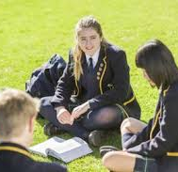
University
Current students for entrance to university in 2025 need to have:
Completed SACE
Gained 90 Stage 2 credits
Ensure they have three 20-credit Stage 2 subjects
Completed the prerequisites needed for their chosen university courses
Most Scotch students use their ATAR for tertiary entrance
Notes:
The most prominent university entrance pathway for Year 12 students is to use their ATAR, and Teresa has already explained how this is calculated. The ATAR can be used to apply to university all around Australia as well as internationally.
But ATAR’s are not the be all of everything…so being aware of alternative pathways for further study after school is always an excellent idea. But first – let’s clarify selection ranks and Bonus points.

Slide 30
Adjustment Factors (Bonus points)
SA Language, Literacy & Mathematics Bonus Scheme
Max 4 points added to Aggregate, then recalculated ATAR
2 per subject (Specialist Mathematics, Maths Methods, English Studies, English, LOTE)
Must get a C- or better
Does NOT apply for Medicine or Veterinary Bioscience
Notes:
You will most likely already have also heard of “Bonus Points” that can enhance a student’s Selection Rank for university entrance. There are many different ways that Bonus Points (or Adjustment Factors as they are officially known) are applied all around Australia. In SA we have one scheme that is applied. It consists of 2 parts. Out of a maximum of 9 bonus points, 5 points can be allocated to a students based on their or their family’s personal financial situation. This essentially means that if the student or a member of their family who they live with receives a regular Centrelink payment then they can be allocated these 5 extra points. The other part of the scheme is based on the subject that a student studies. If a Yr 12 student passes the subject listed on this slide, they are allocated 2 Bonus Points, per subject, to be added on to their aggregate… but it is capped at a maximum of 4 Bonus Points per student. This doesn’t change the student’s ATAR, but it does create a new, enhanced rank which is called a Selection Rank. You will see how these Selection Ranks are used for university entrance in the next few slides.

Slide 31
What do ATARs and Selection Ranks mean?
Notes:
You can see a screenshot here of the admissions data for a degree at the University of Adelaide from last year. It shows data about the ATAR of students who were offered a place in the course, as well as the Selection Rank data for the same cohort of students. The published ATAR cutoff or Selection Rank for a university course is always the lowest ATAR or Selection Rank that received an offer into the course form the most recent cohort of applicants. It essentially is purely a reflection of supply and demand – it is not a reflection of how academically challenging that course is. For example, Civil Engineering has an incredibly challenging academic load at university and has prerequisite subjects of Specialist Maths, Maths Methods and Physics. However, the cutoff Selection Rank is often in the low 80s. This is because there are a large number of places available in the course and so there can be a large number of offers made. There are other courses at Uni that have incredibly high Selection Ranks (such as 99.25) that are nowhere near as academically challenging as Civil Engineering, but because there are a small number of places available in these courses and they are very popular, then the cutoff ATAR and Selection Ranks are very high.

Slide 32
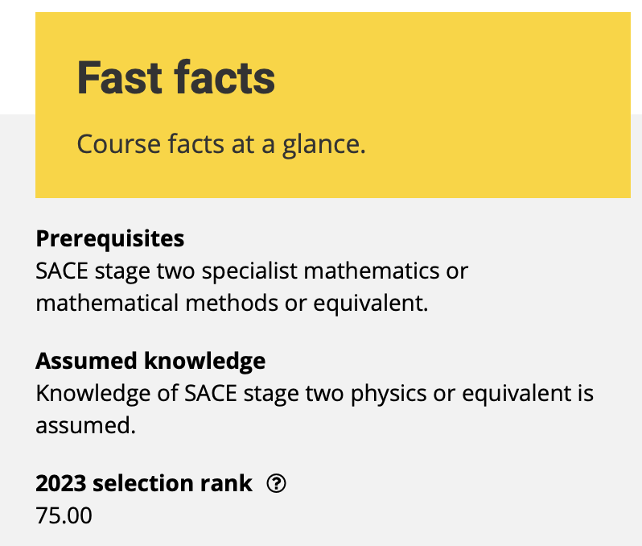
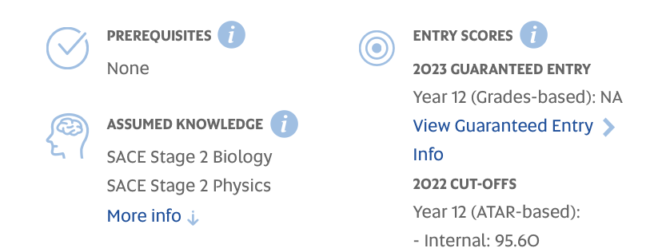
What do you need to know about uni courses?
Notes:
But what else do you need to know about university courses to know if they might suit you? Well, you can see two screenshots from university websites on this slide. On the left is a screenshot for a course from Flinders University. It lists any prerequisite subjects (which are subjects that must be passed at Year 12 level to be allowed entry into the course), it lists assumed knowledge for this course and it also lists the the Selection Rank from the most recent cohort.
On the right hand side you can see a screenshot from a Uni SA course which also contains the same information, but in a different layout. All university websites will list this information about their courses. But we still don’t know much about what the content of the course is - so it’s still too early to know if we might enjoy studying this course.

Slide 33
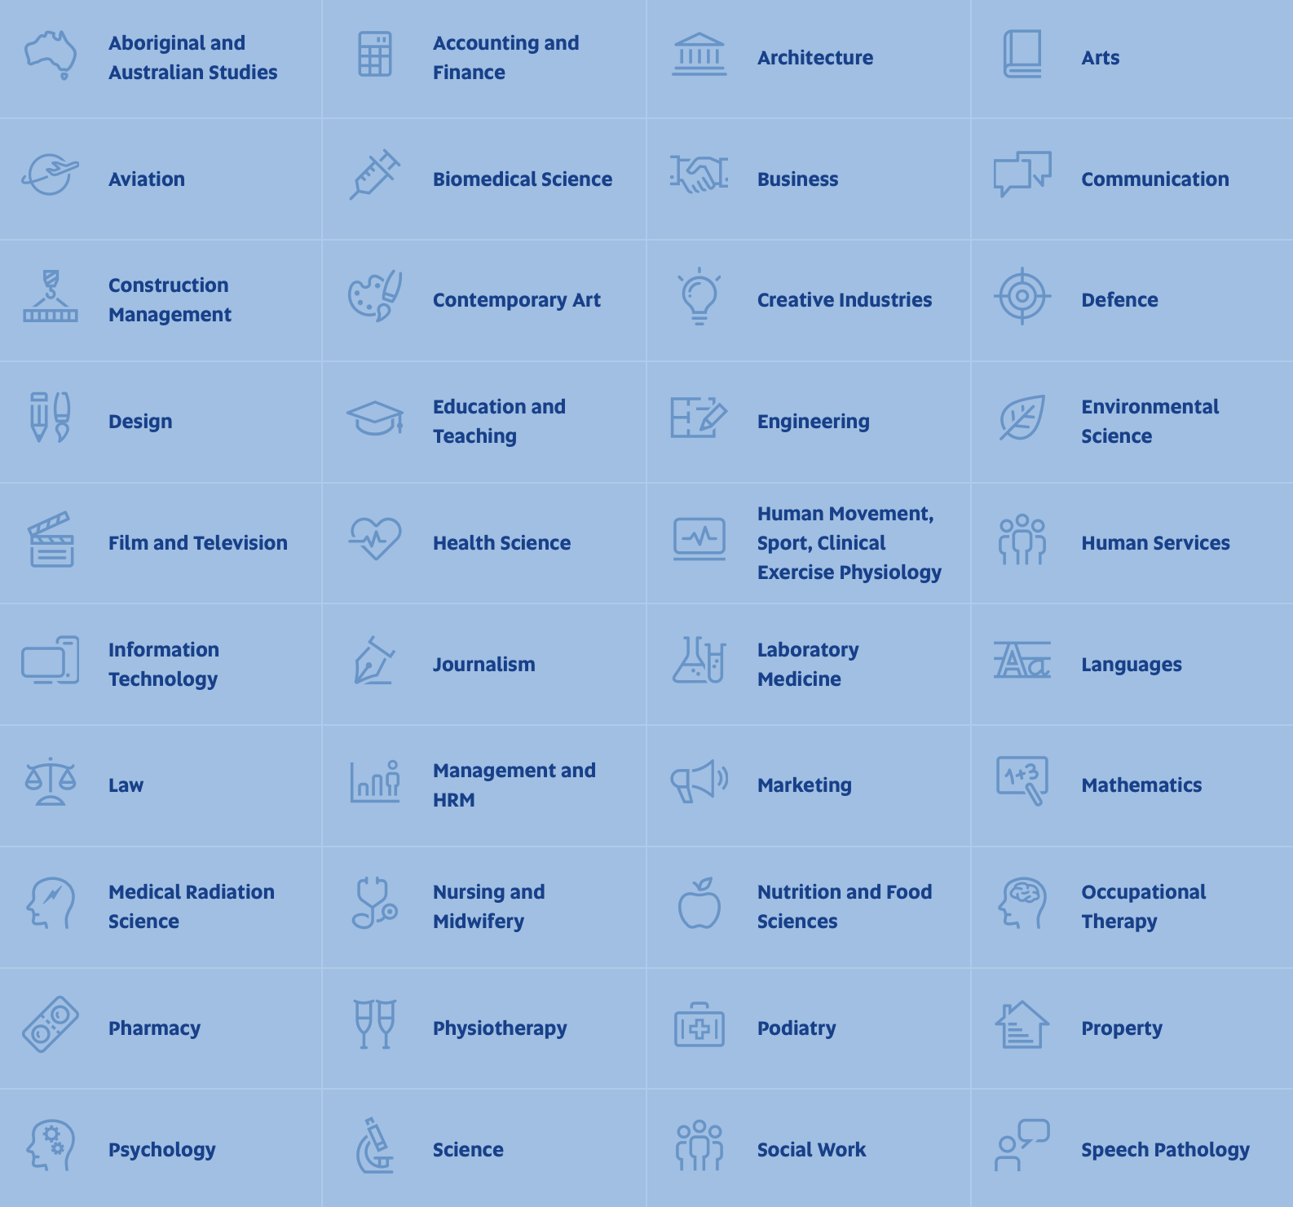
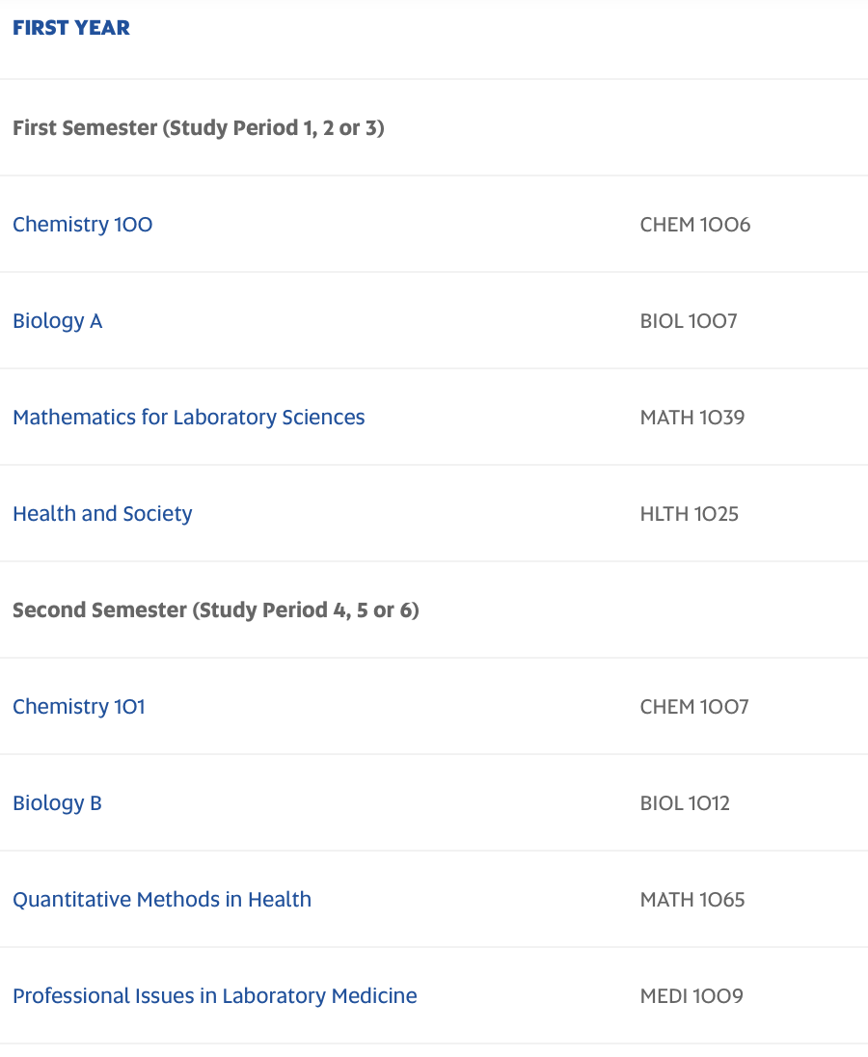
Finding course content
Notes:
It is completely possible to see not only a list of the subjects that are contained within every university course, but to also see a detailed description of the content of each subject as well as the assessment requirements, textbooks, hours involved in lectures and tutorials, etc. I’ve got an example here form the University of South Australia’s website to help show this. I’ve chosen this website because it is currently the easiest one to navigate. I would recommend it as an excellent starting point for researching courses. By going to the Uni SA website and then clicking on “Study” you will then see the selection of blue tiles on the left of the screen. These tiles that can all be clicked on to show the degrees that are available in different subject areas. Let’s click on the “Laboratory Medicine” tile to explore further. (CLICK)
Here you can see a list that (that continues beyond the screenshot) of all of the subjects that you would be studying in this degree. You can see that there is some Chemistry, Biology and Maths… .but the subject “Health in Society” is not able to be immediately understood without more information. If you click on that particular subject, a more detailed summary of the content pops up. (CLICK)

Slide 34
Finding course content
Notes:
We can now see the scope of the content in that subject and can understand what we would be studying for a semester in that subject.
Essentially, by looking through many degrees and the subjects that are contained within them students can get an idea of they like the look of the material in that degree or not… if not, perhaps another type of course would better suit them. Over a period of time this can help students work out what type of degree they might enjoy the most.

Slide 35
Alternative Uni Entry Pathways?
Flinders University – uniTEST, School Recommendation Program, Research Project B, Flinders Foundation Studies, STAT
https://www.flinders.edu.au/study/pathways
University of Adelaide – STAT, University Preparatory program (free, 12 months) https://www.adelaide.edu.au/study/undergraduate/entry-pathways
University of South Australia – Foundation Studies, STAT test, Grades Based Pathway
https://study.unisa.edu.au/study-with-us/entry-pathways/?_gl=1*1pyqtrq*_gcl_au*NDcwNTE5NjQxLjE2OTAwMTIxNTQ
PLUS – Elite Athlete, First Nations, Defence Force and TAFE SA pathways
Notes:
Let’s assume that you have found a course you would like to study and that it is now time to apply for entrance into the course. While a majority of students are offered a place at university based on their ATAR, there are also other ways to be offered a place in the course of your choice. The South Australian public universities currently have the following entrance pathways:
Starting with Flinders Uni….
uniTEST is available to enhance your chances of getting into Flinders. Students are selected based on a combination of their Year 12 results (60% weighting toward the ATAR score) and their uniTEST performance (40%). If you take the test and don’t do so well, then Flinders will only consider the ATAR, so there is no way that this pathway can disadvantage a student.
School Recommendation Program - Flinders Uni knows that your performance in the final year of secondary education is not always a true indicator of your ability to succeed at university, so they will consider a school’s recommendation about your academic performance and potential for university study for admission to a wide range of Flinders courses.
Research Project B pathway is for students who have achieved a B grade or better in the Research Project B subject. These students will be considered for entry into Flinders on your Year 12 results (60% weighting toward the ATAR score), and Research Project B performance (40%).
Uni SA has a Grades Based Pathway that can be used for a large range of its courses (but not it’s most highly competitive ones). This effectively removes any effect of scalaing and entrance criteria for a course is based on the number of A’s, B’s and C’s that a student receives for full year subjects at the end of Year 12.
Flinders Uni, Adelaide Uni and UniSA all offer what’s called the STAT test to help students get into courses. This is a 2 hour multiple choice test that allows students to be ranked on their results and admitted to university courses based purely on that ranking. It is administered by ACER and is completed near the end of Yr 12.
The Uni Prep program and Foundation studies courses at all 3 universities focus on developing the skills required to succeed in an academic tertiary environment. The length of these courses can vary, even at the same university. Upon completion they offer entry to a large range of courses at each university.
Auditions and portfolios of work have always been used as a significant consideration for entrance to Performing Arts and some Creative Arts courses, so entry criteria for these areas does not look largely towards the ATAR.
There are also specialised entry pathways into university for Defence Force personnel, TAFE SA graduates, Elite Athletes and First nations students.
This space will be very interesting in the next few years, as each university has created new and flexible criteria for university entrance as a direct result of the COVID 19 pandemic. We are not yet sure which of these pathways will still apply for the 2024 Yr 12 cohort, but the more flexible approach looks likely to keep creating more opportunities going forward.

Slide 36
Alternative Entry Pathways
Uni TEST (Flinders University)
2 ½ hour test administered by ACER. Not applicable to all Flinders University degrees.
60% ATAR and 40% uniTest OR 100% uniTest (whichever is better for the student)
https://www.flinders.edu.au/study/pathways/year-12-entry/unitest
School Recommendation Program (Flinders University)
https://www.flinders.edu.au/study/pathways/year-12-entry/school-recommendation-program
Research Project B Pathway (Flinders University)
60% ATAR, 40% Research Project B result – automatically calculated by Flinders Uni
https://www.flinders.edu.au/study/pathways/year-12-entry/research-project
Notes:
We have some more details about Flinders University specific entry pathways on this slide. Please click the links to find out more information.

Slide 37
Alternative Entry Pathways
Uni SA – Subject Entry Pathway
Best 3 TAS subjects can get you entry into a range of degrees
STEM Academy (University of Adelaide)
https://www.adelaide.edu.au/stem/academy/year-12-students
Elite Athlete Pathway
https://www.flinders.edu.au/study/sport/elite-athletes
https://www.flinders.edu.au/content/dam/documents/study/domestic/pathways/elite-athletes-admission-scheme.pdf
Notes:
We have mentioned these schemes briefly already, but if you are looking for links for further information, please explore them and see if they could apply to your situation.

Slide 38
Alternative Entry Pathways STAT
The STAT is a nationally recognized 2-hour multiple choice aptitude test
For Semester 1 entry:
In South Australia you must be at least 18 years of age before 1 February in the year of entry to the course.
For Charles Darwin University the minimum age for special entry applicants is 19 years before 1 January in the year of entry.
For Semester 2 entry:
In South Australia you must be at least 18 years of age before 1 July in the year of entry to the course.
For Charles Darwin University the minimum age for special entry applicants is 19 years before 1 July in the year of entry.
Cost – approx $250
Book through ACER and complete in late September/October of Year 12
Notes:
Here we have details about the STAT test. It is worth pointing out that there is an age requirement to be able to use this University entrance pathway, and outside of South Australia it is common for applicants to be required to be 23 years old before this pathway can be an option for them.

Slide 39
Alternative Uni Entry Pathways
Year 11 Results Entry Pathway?
Not yet definitive for 2024 uni entry
Announcement likely in Term 3 (for 2024 start)
Wait and see….. This time next year….
Notes:
Each year the universities clarify if they will be considering student’s Year 11 results as criteria for entry into courses or not. We are still waiting for an announcement to come from both Adelaide University and Flinders University about whether they will allow the current (2023) Yr 12 cohort to use this pathway option. It is therefore not yet known if this will be a pathway option for the 2024 Year 12 cohort.

Slide 40
University/TAFE Open Days
August is “Open Day Month” across Australia
Tours, Open Days, webinars, virtual tours
Subject/course specific presentations
Ask questions directly – email and phone calls direct to universities
Monitor university websites
Check Scotch Life – Future Careers and Pathways – University / TAFE entrance information
Notes:
Something to start looking at in Yr 11 is the university open days. Being able to go on campus and meet course lecturers is enormously helpful in working out where you might like to study. There are lots of specific sessions about courses and the opportunity to ask questions of current students and lecturers, as well as to absorb the atmosphere and see if it feels like the right fit for you. These happen at universities all around Australia throughout August and early September. Having an early look in Year 11 can help settle nerves for making decisions later in Year 12.

Slide 41
University of Adelaide/Uni SA merger - FAQ
https://unisa.edu.au/about-unisa/creating-a-university-for-the-future/#faqs
When will it take effect?
Students will enrol in the University of South Australia or the University of Adelaide up to 2025 entry, then would transfer to the new university, once established in 2026.
What will the ranking of the combined university be?
It is anticipated with a high degree of confidence that the new Adelaide University will be among the top 1% worldwide
Are existing degrees going to be offered at the new university?
It is intended that all program areas offered by the University of Adelaide and the University of South Australia will continue to be delivered, subject to student interest and viability.
Notes:
You have probably heard about the recently announced merger between the University of Adelaide and the University of South Australia. This is an exciting opportunity for university students in South Australia.
Some of the benefits to students are the development of all new curriculum, using innovative content design and delivery methods. It will be co-designed with industry and students and maintain its currency through continuous renewal cycles. Courses will be tailored and flexible to meet the needs of a wide range of students.
Entry requirements will be developed in line with best practice and provide equitable access for all students, and internships, placements, and other kinds of Work Integrated Learning will from a central component of all degrees offered.
You can see a link to a number of frequently asked questions about the new university and the transition process. There are also a couple of key questions on this slide that are included as well.

Slide 42
Where to from here?
Research courses (Content, ATAR, prerequisites, entry requirements & processes)
Research scholarships that might be available
Monitor academic progress
Research accommodation if required
Ring universities/ TAFE directly with specific queries
Speak with your Careers Counsellor if seeking guidance
Belinda Sorensen – Cameron & Douglas
Sam Smith – Gordon & Campbell
Janet Rainey – McGregor & Stewart
Notes:
You have had a lot of information presented this evening, so here is a quick summary of what you can do over the next 17 months to help with some of the big decisions that are coming up. Please reach out and ask questions early so that we can help you find the right fit for you and come up with plans for navigating the change from school to life after SACE.
I’ll now hand back to Teresa Hanel to conclude this evening’s presentation.

Slide 43
Question and Answers
Please use the Q and A at the bottom of the screen or we are more than happy to respond to your questions at anytime.
Teresa Hanel thanel@scotch.sa.edu.au
Belinda Sorensen bsorensen@scotch.sa.edu.au
Sam Smith ssmith@scotch.sa.edu.au
Janet Rainey jrainey@scotch.sa.edu.au

Slide 44
Thank you for listening
Term 3
Online information will be sent out this week
Subject choices due Thursday 17 August 2023
Questions?

